Slide 1
Arrays
Access-Focused Data Storage

Slide 2
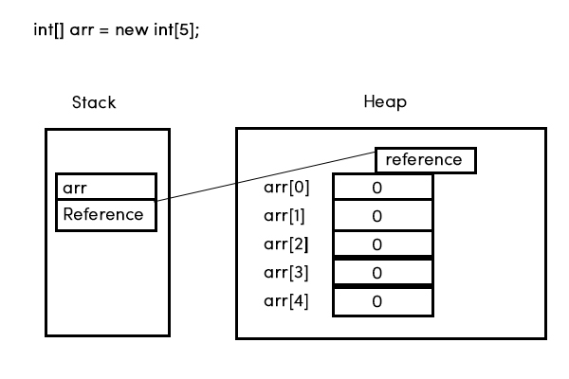
What is an Array?
Array: A collection of elements stored in a contiguous memory block
All elements must be the same type
All elements are stored in a sequential set of memory locations

Slide 3
The Source of Array Efficiency
Arrays are low-level structures
Lower overheads incurred
Arrays are extremely efficient to access!
We know exactly where the array starts in memory
We know exactly how big every element slot is in the array
Combining these things gives us direct access to every position

Slide 4
The Major Limitation of Arrays
Arrays are efficient … until you need to change their fundamentals
You can change the contents of an array extremely easily
Big O cost is O(1)!
You cannot change the structure of an array
No changing the type it stores
No changing the size (number of slots) it contains

Slide 5

Declaring an Array
Declaring an array establishes the type of data to be stored
It does not define the number of slots the array will hold
Declaring a variable before we initialise/create it allows us to control the variable’s scope
To declare an array, we:
Specify the type of data to be stored
Use [] to indicate it’s an array
Give it a variable name
Syntax: dataType [] variableName;

Slide 6

Initialising an Array
Initialising/creating an array triggers it to be built in memory
Declaring it allocates a variable slot for its reference/location
Creating it allocates the contiguous memory for the storage structure itself
To create an empty array, we:
Use the new keyword
Specify the type being stored
Specify the array’s size, i.e. the number of spaces/slots the array should contain (done within [])
Syntax: variableName = new datatype[arraySize];

Slide 7

Combo Move!
Declaration and creation do not have to be done separately
We frequently combine these actions
The syntax basically joins the two together:
dataType [] variableName = new datatype[arraySize];

Slide 8

Creating a Populated Array
Creating an array populated with a specific collection of elements is a bit different
Declaration step is the same
Creation step changes: Instead of creating an array of a specified size, we just give it the elements and let it figure that out
Arrays built in this manner are exactly the size of the dataset they’re created from
If you have a collection of 3 elements, the array will have 3 slots
If you have a collection of 800 elements, the array will have 800 slots
Syntax: dataType [] variableName = {element1, element2, … elementN};

Slide 9
Accessing Array Elements
You access an array element based on its position (starting from 0)
Same as in python!
Why do you think it works this way?
Syntax: arrayName[position]
If the position doesn’t exist, you will get an ArrayIndexOutOfBoundsException
Unlike python, you cannot index backwards
If you provide a position/index value < 0, it will throw an exception

Slide 10
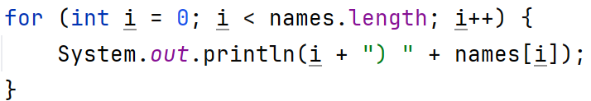
Getting an Array’s Size
Unlike python, we do not have a general method to get the length of everything
In python, you ask len to calculate the size of a thing
In Java, you ask the thing itself how big it is
To find the length/size of an array, you get its length
Syntax: arrayName.length;
Note: No parentheses!

Slide 11
Displaying an Array
In memory, Java variables contain one of two things:
Real data (primitives)
References to where the data is stored (objects)
Arrays are objects, therefore their variables contain memory references
When you print one out, you see this reference, NOT its data contents
To print the content of an array, you can:
Loop through and print each position (see previous slide)
Use a helper method to do it for you – Arrays.toString(arrayName);

Slide 12

Changing an Array – Altering its Contents
To change the content of a slot in an array, we simply write into that position
No such thing as python’s append, insert, pop, remove etc
Syntax: arrayName[position] = value;
Note: You can change data, but cannot change the type
The array can only accept values that are the same type as the overall array.

Slide 13
Changing an Array – Altering its Size
This is impossible
As an array is created as a contiguous sequence in memory, adding on to this is not permitted
Java cannot guarantee that that space is not already occupied
To optimise the process, it just assumes the extra space is not available and bans it
The workaround:
Create a new bigger/smaller version of the original array
Copy every element to be retained over to the new version
Save the new version in the variable name of the original array

Slide 14
Info: Multidimensional Arrays
AKA 2D arrays - Allows each slot to contain its own array
Equivalent to a list of lists in python, but with more rules
All arrays must contain the same data type
All arrays must contain the same number of slots
Syntax: dataType [] variableName = new datatype[numRows][numColumns];
These aren’t common, but can be very useful in some areas

